Slide 1


HDFS & YARN
ZAHEER AHMED
i-Learn | a T&D initiative

Slide 2

Agenda
HDFS:
1.The design of HDFS
2.HDFS Concepts
Blocks
Name node and Data nodes
Block Caching
HDFS federation
HDFS High availability
3.Data Flow
File Read
File Write
YARN
1.Anatomy of Yarn application run.
Resource Requests
2.Failure Mechanism in YARN
3.Scheduling in YARN
i-Learn | a T&D initiative

Slide 3
Data Storage
In 1990 you could store 1370MB of data and had a transfer speed of 4.4MB/s.so you could read all the data from the full drive in around 5 minutes.
Over 20 years later, 1 – terabyte drives are the norm, but the transfer speed is around 100MB/s, so it takes two and half hour to read all the data from the disk.
Solution:
This is a long time to read all data on a single drive – and writing is even slower. The obvious way to reduce the time is to read from multiple disks at once. Imagine if we had 100 disks, each holding one hundredth of the data. Working in parallel we could read the data under two minutes.
i-Learn | a T&D initiative

Slide 4
1.The design of HDFS
HDFS is a filesystem designed for storing very large files with streaming data access patterns, running on clusters of commodity hardware.
Very large files
“Very large” in this context means files that are hundreds of megabytes, gigabytes, or terabytes in size. There are Hadoop clusters running today that store petabytes of data.
Streaming data access
HDFS is built around the idea that the most efficient data processing pattern is a write-once, read-many-times pattern. A dataset is typically generated or copied from source, and then various analyses are performed on that dataset over time. Each analysis will involve a large proportion, if not all, of the dataset, so the time to read the whole dataset is more important than the latency in reading the first record.
Commodity hardware
Hadoop doesn’t require expensive, highly reliable hardware. It’s designed to run on clusters of commodity hardware (commonly available hardware that can be obtained from multiple vendors) for which the chance of node failure across the cluster is high, at least for large clusters. HDFS is designed to carry on working without a noticeable interruption to the user in the face of such failure.

Slide 5
HDFS is not designed for…
Low-latency data access
Applications that require low-latency access to data, in the tens of milliseconds range, will not work well with HDFS. Remember, HDFS is optimized for delivering a high throughput of data, and this may be at the expense of latency
Lots of small files
Because the namenode holds filesystem metadata in memory, the limit to the number of files in a filesystem is governed by the amount of memory on the namenode. As a rule of thumb, each file, directory, and block takes about 150 bytes. So, for example, if you had one million files, each taking one block, you would need at least 300 MB of memory. Although storing millions of files is feasible, billions is beyond the capability of current hardware.
Multiple writers, arbitrary file modifications
Files in HDFS may be written to by a single writer. Writes are always made at the end of the file, in append-only fashion. There is no support for multiple writers or for modifications at arbitrary offsets in the file.

Slide 6
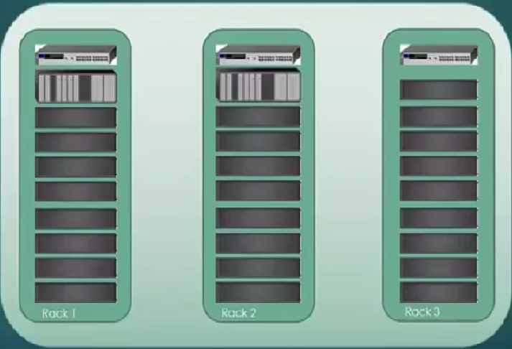
Terminologies
file1
Name Node
Nodes
Data
Cluster
Racks
Blocks

Slide 7
HDFS Architecture
Remote NFS
DN
MASTER
Complete File System Image
X
Namespace Image
Edit Log
NN
DN
DN
SNN

Slide 8
2.HDFS Concepts
HDFS Blocks:
Block size is the minimum size of data that can be read or written to a file system.
Typically for a disk it is 512 bytes, but for HDFS its default is 128MB.
A file smaller then the block size does no occupy a full block in HDFS.
Why is block size so large?
HDFS blocks are large compared to disk blocks, and the reason is to minimize the cost of seeks. If the block is large enough, the time it takes to transfer the data from the disk can be significantly longer than the time to seek to the start of the block. Thus, transferring a large file made of multiple blocks operates at the disk transfer rate.
A quick calculation shows that if the seek time is around 10 ms and the transfer rate is 100 MB/s, to make the seek time 1% of the transfer time, we need to make the block size around 100 MB. The default is actually 128 MB, although many HDFS installations use larger block sizes. This figure will continue to be revised upward as transfer speeds grow with new generations of disk drives.

Slide 9
2.HDFS Concepts
HDFS Blocks:
Benefits of having a block abstraction:
A file can be larger than any single disk in the network. There’s nothing that requires the blocks from a file to be stored on the same disk, so they can take advantage of any of the disks in the cluster.
Making the unit of abstraction a block rather than a file simplifies the storage subsystem. Simplicity is something to strive for in all systems, but it is especially important for a distributed system in which the failure modes are so varied. The storage subsystem deals with blocks, simplifying storage management (because blocks are a fixed size, it is easy to calculate how many can be stored on a given disk) and eliminating metadata concerns (because blocks are just chunks of data to be stored, file metadata such as permissions information does not need to be stored with the blocks, so another system can handle metadata separately)
Furthermore, blocks fit well with replication for providing fault tolerance and availability. To insure against corrupted blocks and disk and machine failure, each block is replicated to a small number of physically separate machines (typically three). If a block becomes unavailable, a copy can be read from another location in a way that is transparent to the client. A block that is no longer available due to corruption or machine failure can be replicated from its alternative locations to other live machines to bring the replication factor back to the normal level

Slide 10
2.HDFS Concepts
NameNode:
It maintains the filesystem tree and the metadata for all the files and directories in the tree. This information is persistently stored on the local disk in the form of two files :
The Namespace image
The Edit Log
It also knows the datanodes on which all the blocks of the given file are located.
DataNodes:
These are the work horses of the filesystem. They store and retrieve blocks when they are told to by client or namenode and they report back to the namenode periodically with list of blocks that they are storing.
Secondary NameNode:
Its main role is to merge the namespace image with the edit log to prevent the edit log from becoming too large.
The SNN runs on a separate machine since it requires plenty of CPU ad as much memory as the namenode to perform the merge.

Slide 11
2.HDFS Concepts
Block Caching:
Normally a datanode reads blocks from disk, but for frequently accessed files the blocks may be explicitly cached in the datanode’s memory, in an off-heap block cache.
By default, a block is cached in only one datanode’s memory, although the number is configurable on a per-file basis.
Job schedulers (for MapReduce, Spark, and other frameworks) can take advantage of cached blocks by running tasks on the datanode where a block is cached, for increased read performance.
i-Learn | a T&D initiative

Slide 12
2.HDFS Concepts
HDFS Federation
/root
/folder1
/folder2
/folder1
NN
NN
NN
/folder2
Name Node1
Name Node
Name Node2
DN
DN
DN
DN
DN
DN

Slide 13
2.HDFS Concepts
HIGH AVAILABILITY
Namespace
Edit Image
NN
NN
NN
Zookeeper
DN
DN
DN
DN
DN
DN

Slide 14
3.Data Flow : File write
a.txt
B1 : 1,4,5
B2 : 1,2,3
B3 : 3,5,6
B4 : 2,3,4
a.txt
B1 : 1,4,5
B2 : 1,2
B3 : 3,5
B4 : 2,3,4
CLIENT
Write request
a.txt
B1 : 1,4,5
B2 : 1,2,6
B3 : 3,5,6
B4 : 2,3,4
a.txt
400MB
NN
1,4,5
128MB
128MB
DN 1
DN 2
DN 3
128MB
128MB
128MB
128MB
128MB
128MB
128MB
16
MB
16
MB
16
MB
X
DN 4
DN 5
DN 6
128MB
128MB
128MB
16
MB
128MB
128MB

Slide 15
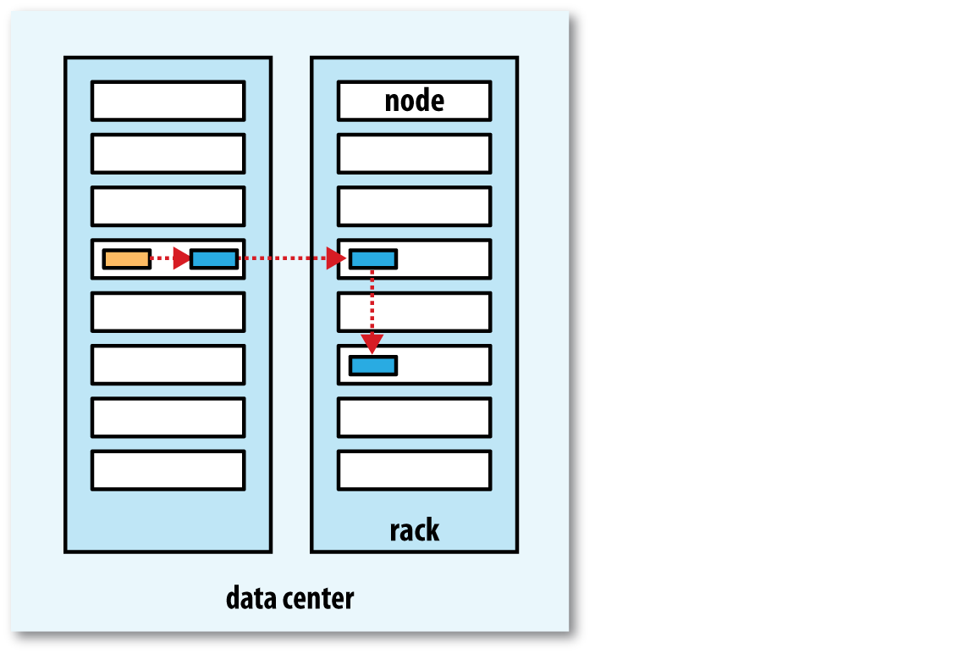
Replica Placement
Hadoop’s default strategy is to place the first replica on the same node as the client (for clients running outside the cluster, a node is chosen at random, although the system tries not to pick nodes that are too full or too busy).
The second replica is placed on a different rack from the first (off-rack), chosen at random.
The third replica is placed on the same rack as the second, but on a different node chosen at random.

Slide 16
Data Flow: File Read
CLIENT
Read request
a.txt
B1 : 1,4,5
B2 : 1,2,6
B3 : 3,5,6
B4 : 2,3,4
a.txt
400MB
NN
B1 : 1,4,5
B2 : 1,2,6
B3 : 5,3,6
B4 : 4,2,3
DN 1
DN 2
DN 3
128MB
128MB
128MB
128MB
16
MB
16
MB
X
DN 6
DN 4
DN 5
128MB
128MB
128MB
16
MB
128MB
128MB

Slide 17
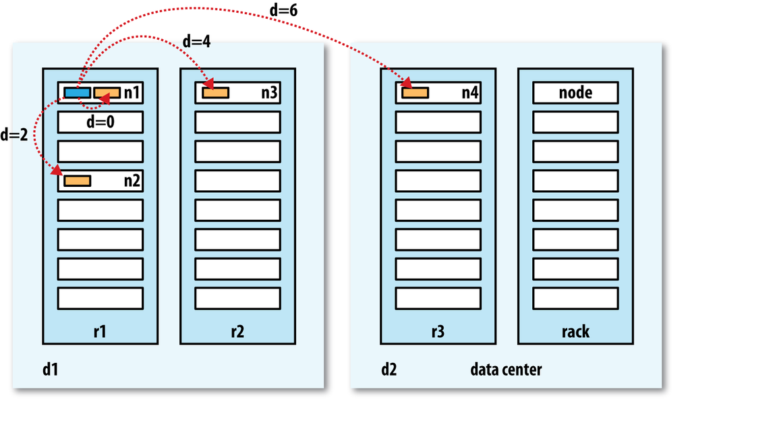
NETWORK TOPOLOGY AND HADOOP
distance(/d1/r1/n1, /d1/r1/n1) = 0 (processes on the same node)
distance(/d1/r1/n1, /d1/r1/n2) = 2 (different nodes on the same rack)
distance(/d1/r1/n1, /d1/r2/n3) = 4 (nodes on different racks in the same data center)
distance(/d1/r1/n1, /d2/r3/n4) = 6 (nodes in different data centers)

Slide 18
Hadoop Commands
hadoop fs -mkdir -p /user/maxtemp
hadoop fs -ls /user/
hadoop fs -put ~/workspace/input/maxtemperature/1901.gz /user/maxtemp/
hadoop jar /home/hduser/workspace/MaxTemperature/target/MaxTemperature.jar com.hadoop.maxtemperature.driver.MaxTemperatureDriver /user/maxtemp/1901.gz /home/hduser/workspace/output27
hadoop fs -ls /home/hduser/workspace/output27
hadoop fs -cat /home/hduser/workspace/output27/part-r-00000

Slide 19
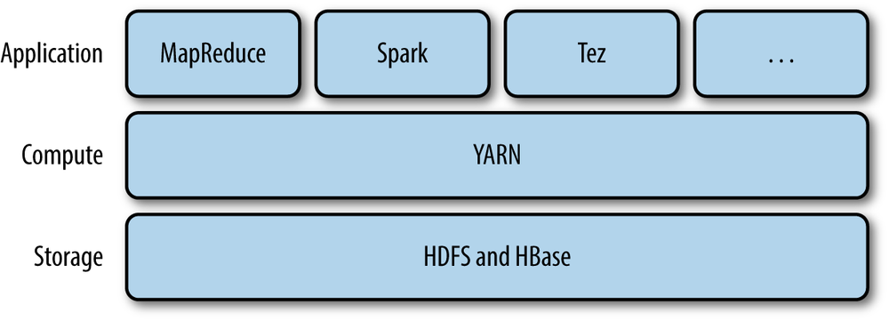
YARN:Yet Another Resource Negotiator
It is Hadoop’s cluster resource management system.

Slide 20
YARN Components
Resource Manager:
It is one per cluster to manage the use of resources across the cluster
It manages the use of resources across the cluster
Node Manager:
It runs on all the nodes in the cluster to launch and monitor containers.
A container executes an application specific process with a constrained set of resources(memory, CPU and so on).
Application Master
It could simply run a computation and return the result to the client.
Or it could request more containers from the resource manager and use them to run the distributed computation.

Slide 21
Anatomy of Yarn application run
1:get new application
Application Client
Resource Manager
3:submit yarn application
Client Node
Resource Manager Node
4a:start container
5:allocate resources
2:copy job resources
Node Manager
4b:launch
Container
MR Application Master
5a:start container
Node manager node
Node Manager
5b:launch
6:retrieve job resources
Container
HDFS
Map Task or Reduce Task
Node manager node

Slide 22
Resource Requests
Locality is critical in ensuring that distributed data processing algorithms use the cluster bandwidth efficiently, so YARN allows an application to specify locality constraints for the containers it is requesting. Locality constraints can be used to request a container on a specific node or rack, or anywhere on the cluster (off-rack).
Sometimes the locality constraint cannot be met, in which case either no allocation is made or, optionally, the constraint can be loosened. For example, if a specific node was requested but it is not possible to start a container on it (because other containers are running on it), then YARN will try to start a container on a node in the same rack, or, if that’s not possible, on any node in the cluster.

Slide 23
2.Failure Mechanism in YARN
X
Application Client
Resource Manager
Client Node
Resource Manager Node
Node Manager
X
Container
Node Manager
MR Application Master
Map Task or Reduce Task
Container
X
Node manager node
MR Application Master
Node Manager
Node Manager
Node manager node
X
Container
Container
Map Task or Reduce Task
Map Task or Reduce Task
Node manager node
Node manager node

Slide 24
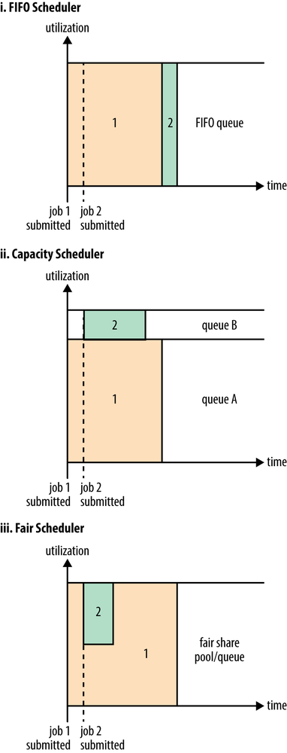
3.Scheduling in YARN

Slide 25
Thank You

